Slide 1


SC1015: Introduction
To Data Science &
Artificial Intelligence
Mini-Project:
Phishermen’s Cove
Presented by:
Aidan Ling Zhen Yang
Lau Quan Feng, Ryan
Shem Lau Wei Yi

Slide 2
Introduction
Content Outline
01
Practical Motivation
Outlines our rationale for focusing on phishing website detection and its importance in today’s digital world
02
Data Preparation
Outlines our dataset selection process, initial feature selection, and cleaning & sampling of the data
03
Exploratory Analysis
Outlines our analysis of selected features and their relationship to phishing characteristics.
04
Feature Engineering
Outlines our attempts to create new, more informative features from our existing data
05
Machine Learning
Outlines the implementation of various machine learning models for phishing website classification
Source:

Slide 3

Practical Motivation
Definition of Phishing
What exactly is Phishing?
A technique for attempting to acquire sensitive data, such as bank account numbers, through a fraudulent solicitation in email or on a website, in which the perpetrator masquerades as a legitimate business or reputable person.
Source: https://csrc.nist.gov/glossary/term/phishing

Slide 4
Practical Motivation
Phishing Incidence Rate in Singapore
In 2022…
8,500
Phishing Attempts
In 2021…
3,100
Phishing Attempts
Source: https://www.csa.gov.sg/Tips-Resource/publications/2023/singapore-cyber-landscape-2022

Slide 5
2,918
Phishing Websites Taken Down
98
Security Advisories Published
Practical Motivation
Phishing Incidence Rate in Singapore
In 2022…
8,500
Phishing Attempts
In 2021…
3,100
Phishing Attempts
Source: https://www.csa.gov.sg/Tips-Resource/publications/2023/singapore-cyber-landscape-2022

Slide 6
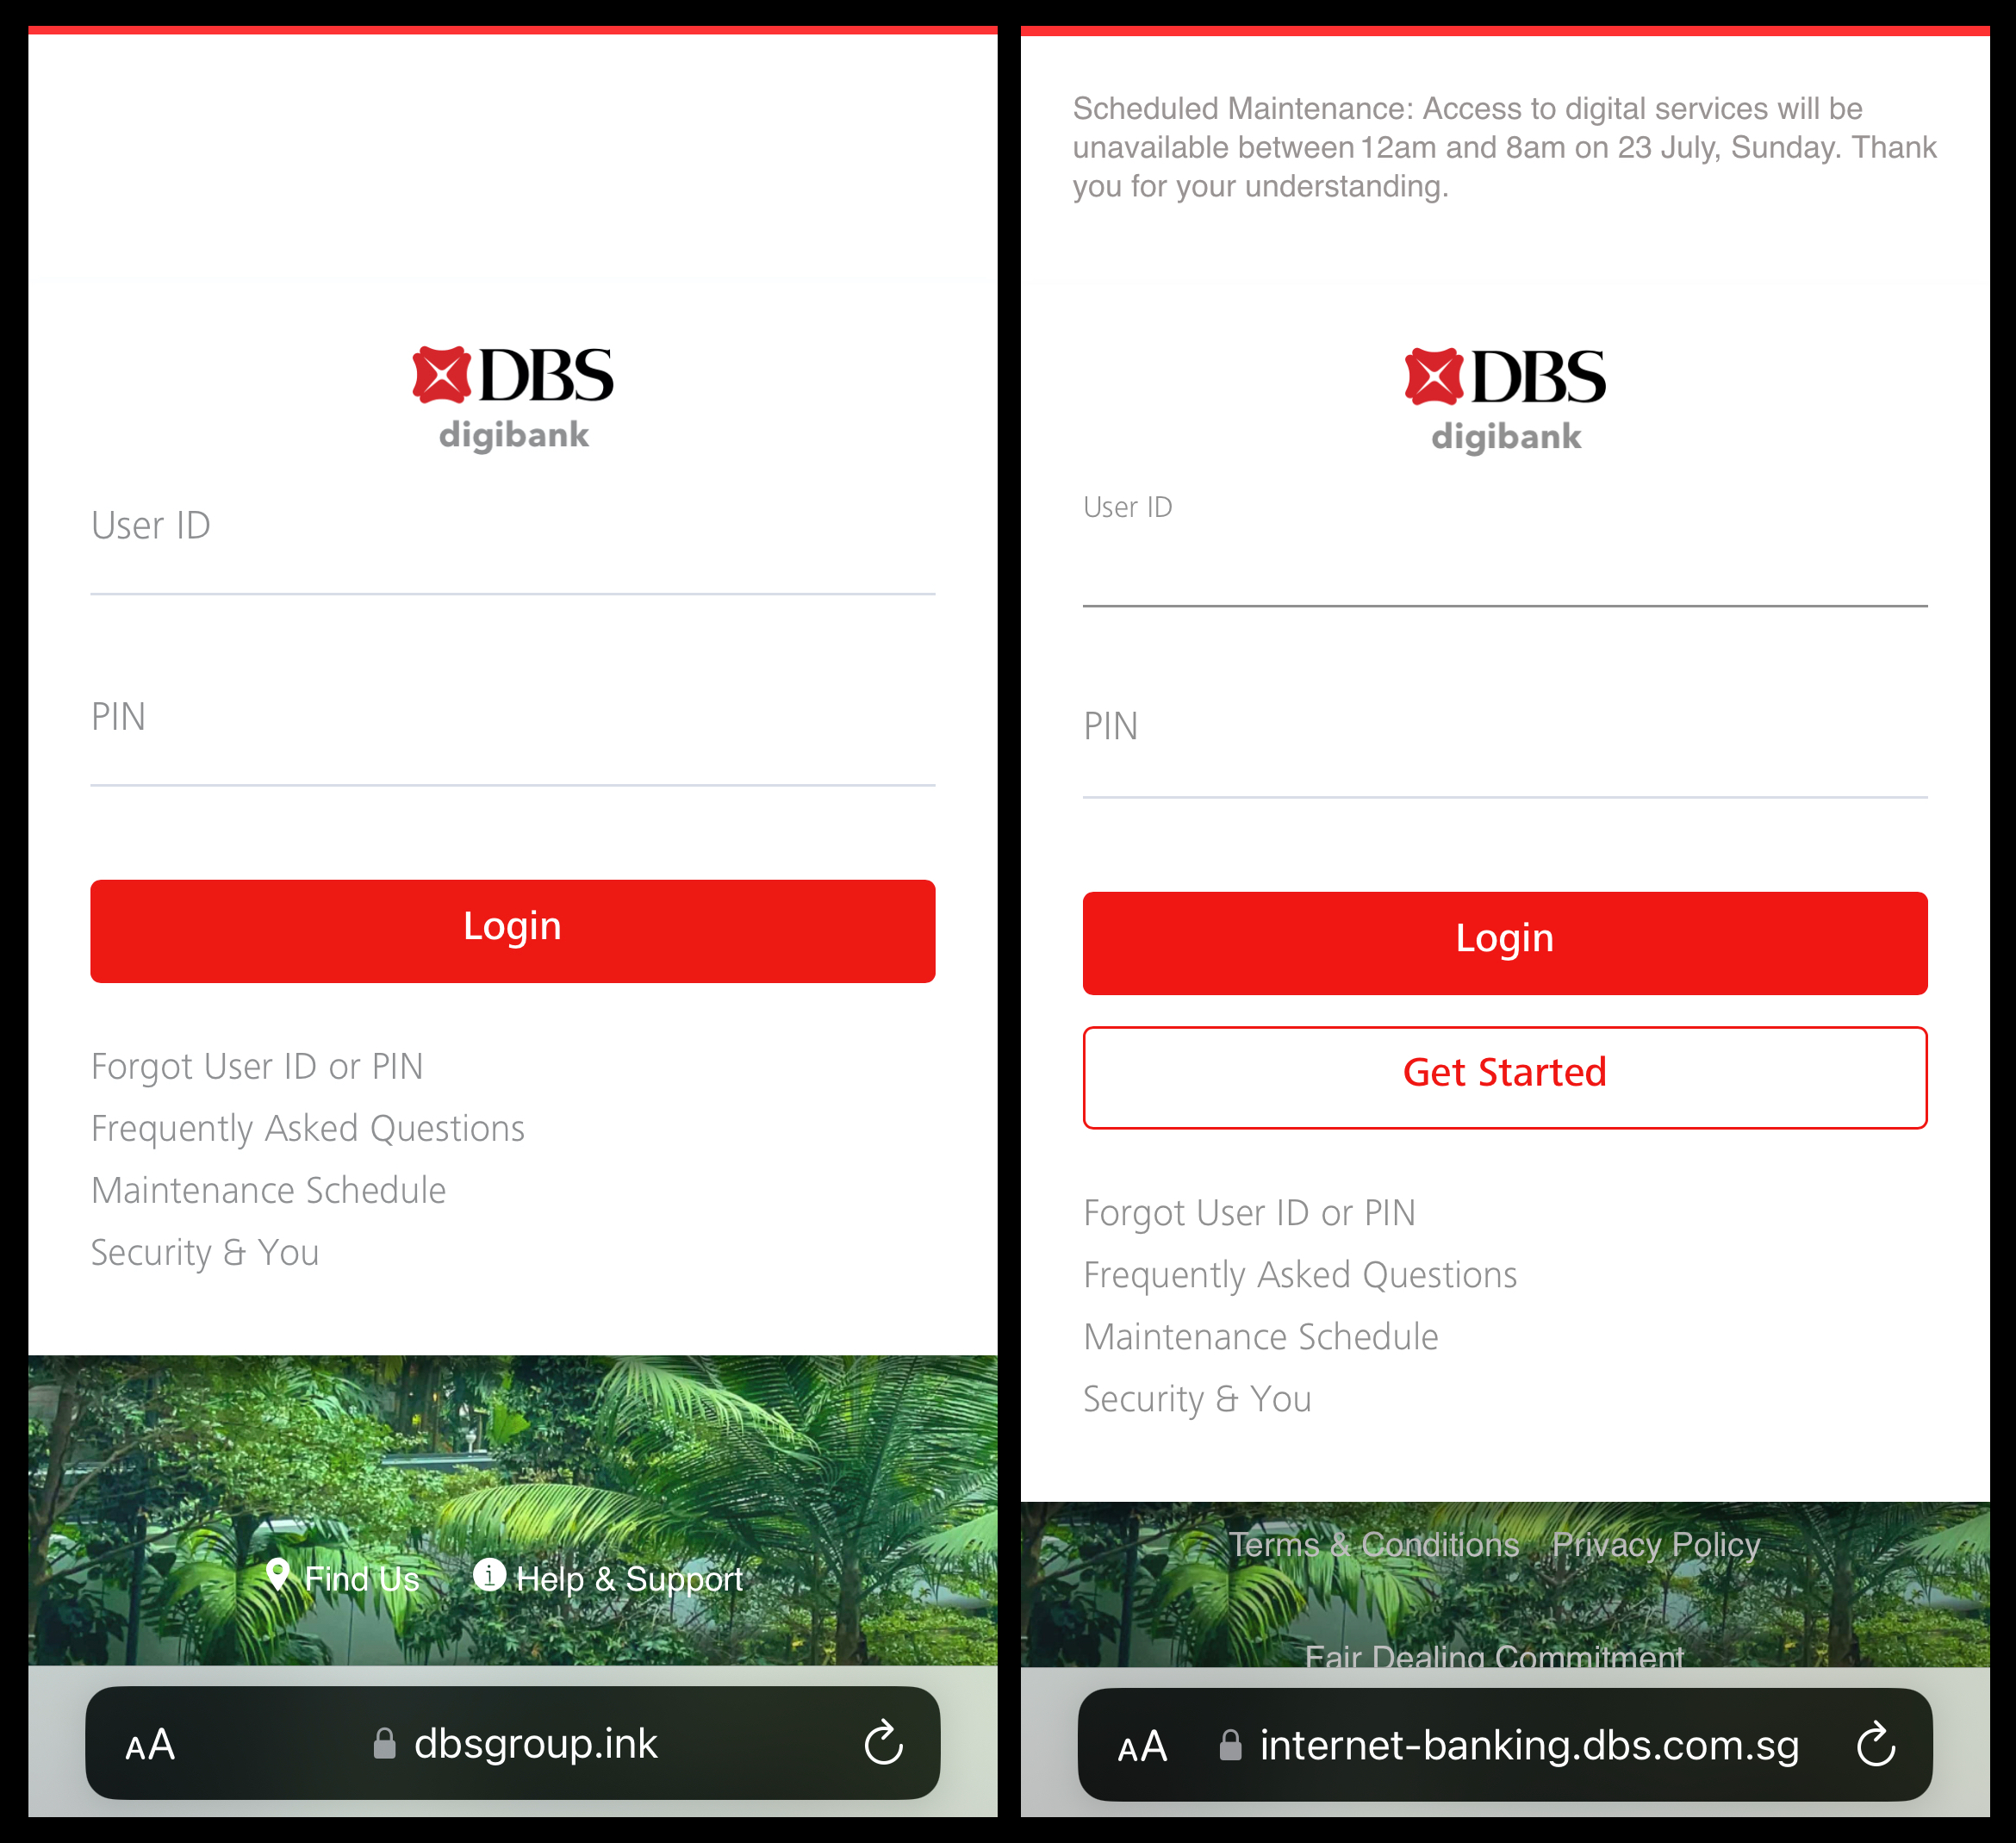

Practical Motivation
Challenge of Tackling Phishing
Source: https://www.reddit.com/r/singapore/comments/156etev/spot_the_real_site/

Slide 7

Practical Motivation
Introduction to Phishermen’s Cove
Phishermen’s Cove
Project to employ data analytics and machine learning techniques to detect potentially harmful phishing websites.

Slide 8
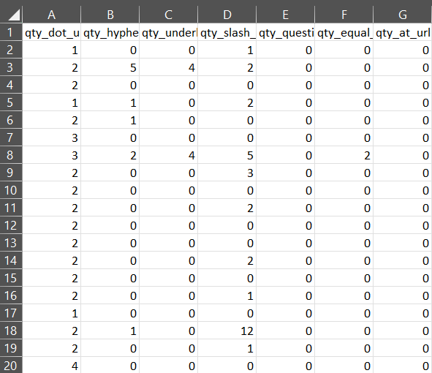
Data Preparation
Selecting our dataset
Primary Dataset: Phishing Domain Attributes
This dataset comprises a comprehensive collection of over 80 different features extracted from URLs, designed to facilitate the detection and analysis of phishing domains.
Potential URL characteristics include:
Numerical:
Number of dots (.), hyphens (-), and forward slashes (/)
Categorical:
Whether a URL is indexable by Google Search
URL Attributes: https://www.kaggle.com/datasets/michellevp/dataset-phishing-domain-detection-cybersecurity
Actual Phishing URLs: https://www.kaggle.com/datasets/sid321axn/malicious-urls-dataset
Data Preparation

Slide 9
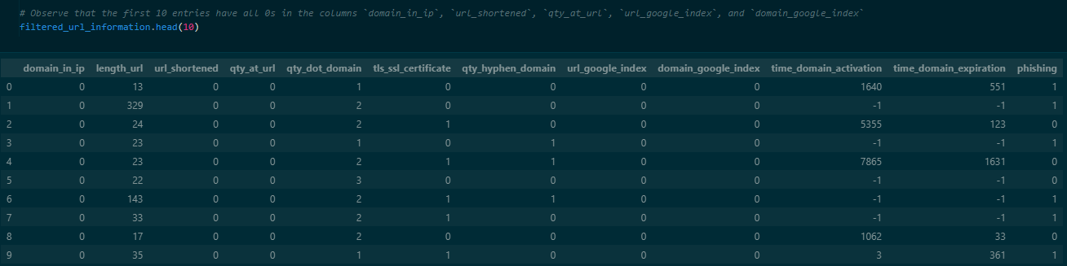
Data Preparation
Extracting Useful Data
Column Name | Description
domain_in_ip | Domain name contains an IP Address
length_url | Length of the URL
url_shortened | Whether a URL has been shortened
qty_at_url | Quantity of "@" symbols in the URL
qty_dot_domain | Quantity of “.” symbols in the domain
tls_ssl_certificate | Whether a site uses HTTPS
qty_hyphen_domain | Quantity of “-” symbols in the domain
url_google_index | Whether a URL can be indexed by Google Search
domain_google_index | Whether a domain name can be indexed Google index
time_domain_activation | Time that the domain has been active
time_domain_expiration | Time left until the domain expires
URL Attributes
Actual Phishing URLS
URL Features: https://eprints.hud.ac.uk/id/eprint/24330/6/MohammadPhishing14July2015.pdf

Slide 10
Data Preparation
Cleaning & Sampling the Data
URL Attributes
Actual Phishing URLS
URL Features: https://eprints.hud.ac.uk/id/eprint/24330/6/MohammadPhishing14July2015.pdf

Slide 11
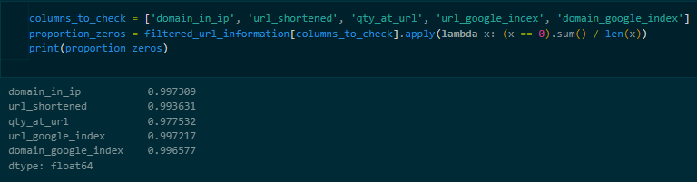
Data Preparation
Cleaning & Sampling the Data
URL Attributes
Actual Phishing URLS
Observe that the first 10 entries have all 0s in the following columns: domain_in_ip, url_shortened, qty_at_url, url_google_index, and domain_google_index
URL Features: https://eprints.hud.ac.uk/id/eprint/24330/6/MohammadPhishing14July2015.pdf

Slide 12
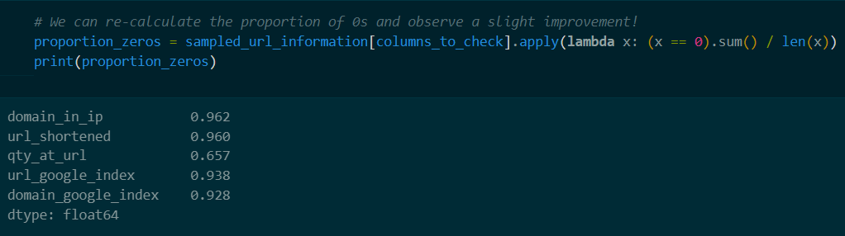
Data Preparation
Cleaning & Sampling the Data
URL Attributes
Actual Phishing URLS
Calculated the proportion of 0s as a fraction of the total entries, and we observed that around 97-99% of the entire column are zero-valued
URL Features: https://eprints.hud.ac.uk/id/eprint/24330/6/MohammadPhishing14July2015.pdf

Slide 13
Data Preparation
Cleaning & Sampling the Data
URL Attributes
To improve data quality and avoid disproportionate representation, we performed the following steps:
Actual Phishing URLS
Randomly selected 500 samples where at least one these columns have non-zero values, with no duplicate entries.
The remaining 500 entries were randomly chosen from the entire dataset, with no duplicates entries.
URL Features: https://eprints.hud.ac.uk/id/eprint/24330/6/MohammadPhishing14July2015.pdf

Slide 14
Mixed
Variable
Categorical Variable
Numerical
Variable
Exploratory Analysis
Classifying our Variables
Data Preparation

Slide 15
Exploratory Analysis
Classifying our Variables
domain_in_ip, url_shortened, tls_ssl_certificate, url_google_index, domain_google_index, phishing
Mixed
Variable
length_url
Categorical Variable
Numerical
Variable
time_domain_activation, time_domain_expiration, qty_at_url, qty_dot_domain, qty_hyphen_domain
Data Preparation

Slide 16
Exploratory Analysis
Classifying our Variables
Categorical Variable
domain_in_ip, url_shortened, tls_ssl_certificate, url_google_index, domain_google_index, phishing
Numerical
Variable
length_url
Mixed
Variable
time_domain_activation, time_domain_expiration, qty_at_url, qty_dot_domain, qty_hyphen_domain
Data Preparation

Slide 17
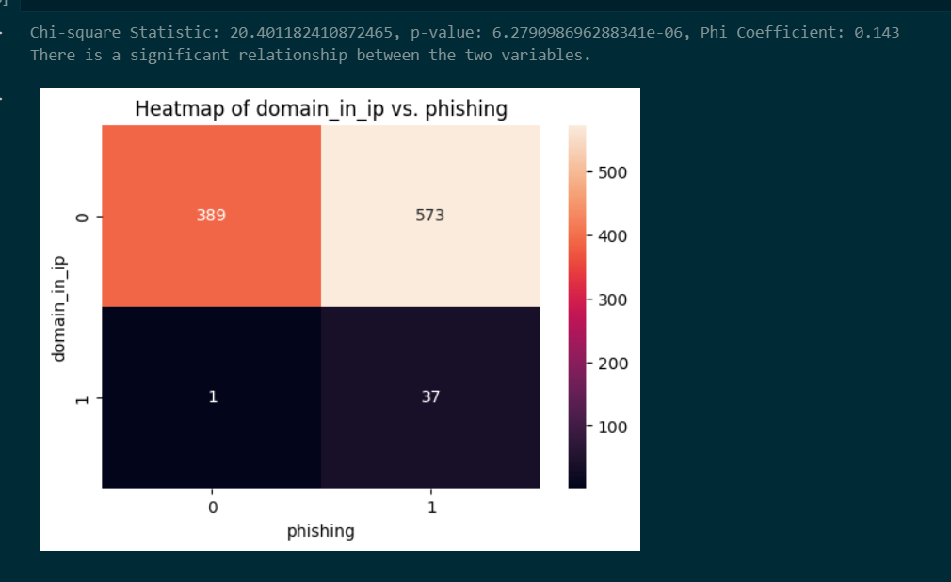
Exploratory Analysis
Analysing Categorical Variables
Analysing Categorical Variables
1. Chi-Square Test of Independence:
Null Hypothesis: No relationship exists between the categorical variable and phishing status.
Alternative Hypothesis: There is a relationship between the categorical variable and phishing status.
2. Phi Coefficient:
This measure helps determine the strength and direction of the association between the categorical variables and the phishing variable.

Slide 18
Exploratory Analysis
Analysing Categorical Variables
Analysing Categorical Variables
High Chi-Square values (10 to 40)
Low p-values (< 0.05)
Low Phi Coefficient (< 0.2)
This weak correlation may be due to a small proportion of non-zero values in these categorical variables (less than 10% of the sample).
Notes:
Our contingency tables show a statistically significant relationship between certain categorical variables and phishing activity. This is supported by high Chi-Square values (10-40~) and low p-values (<0.05). However, the Phi Coefficient suggests a very weak correlation (<0.2).
We suspect the weak correlation might be caused by few positive values within the categorical variables (<10% of the sample). Further analysis revealed that the proportion of phishing websites is higher within these positive values, supporting our suspicion.

Slide 19
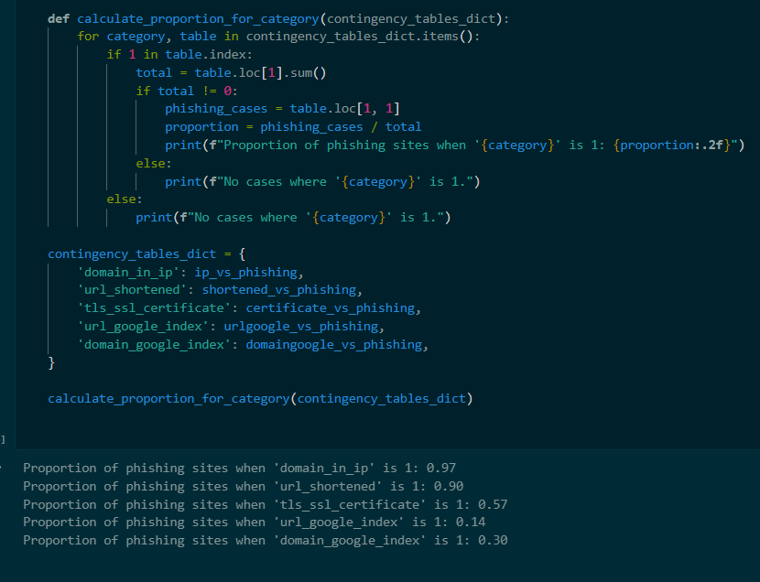
Exploratory Analysis
Analysing Categorical Variables
Analysing Categorical Variables
Positive: domain_in_ip and url_shortened exhibit stronger positive correlations.
Negative: url_google_index and domain_google_index demonstrate negative correlations.
Weak Indicator: tls_ssl_certificate appears less reliable as an indicator due to its weak correlation.

Slide 20
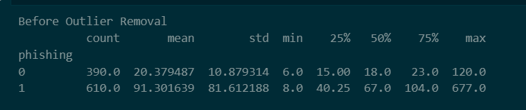
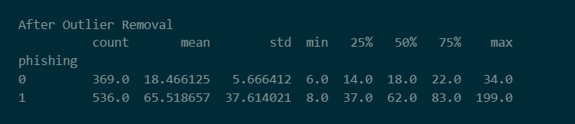
Exploratory Analysis
Analysing Numerical Variables
Analysing Numerical Variables
Basic Statistical Analysis: Analysing basic summary statistics offers quick insights into how the data is distributed.

Slide 21
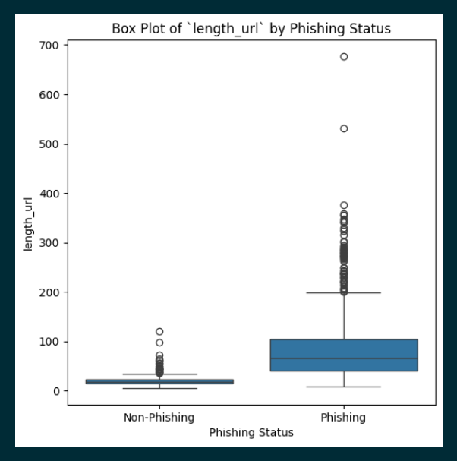
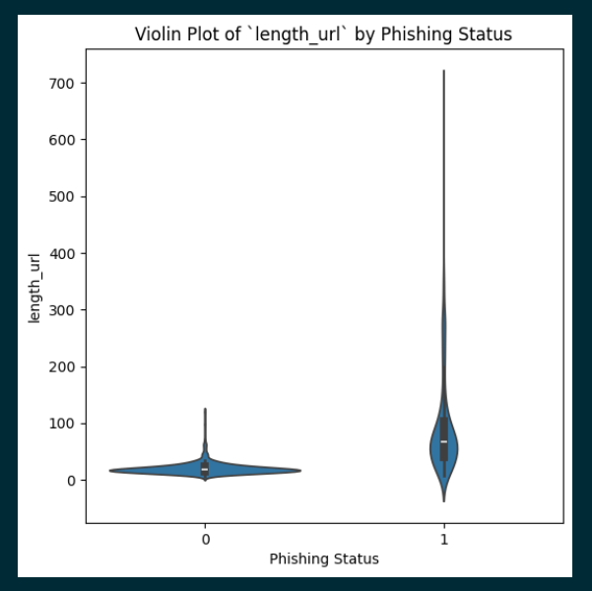
Exploratory Analysis
Analysing Numerical Variables
Before Removing Outliers
Visualisation: Box plots and Violin Plots can help illustrate the distribution of each numerical variable for both phishing and non-phishing websites,

Slide 22
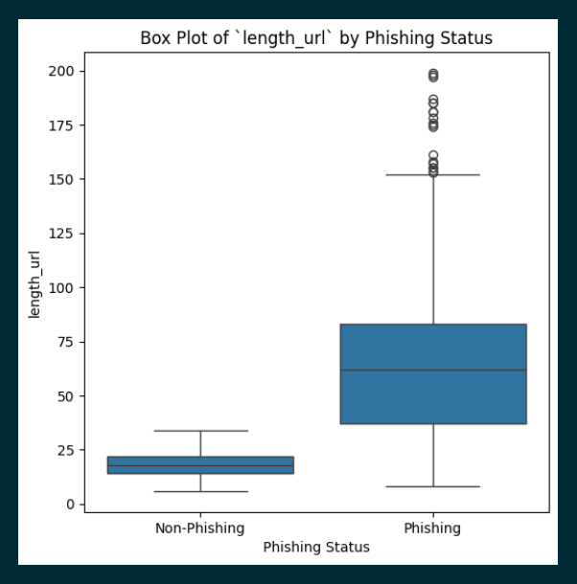
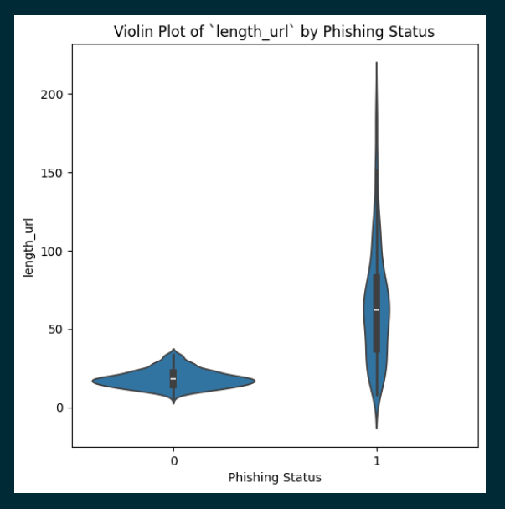
Exploratory Analysis
Analysing Numerical Variables
After Removing Outliers
Visualisation: Box plots and Violin Plots can help illustrate the distribution of each numerical variable for both phishing and non-phishing websites,

Slide 23
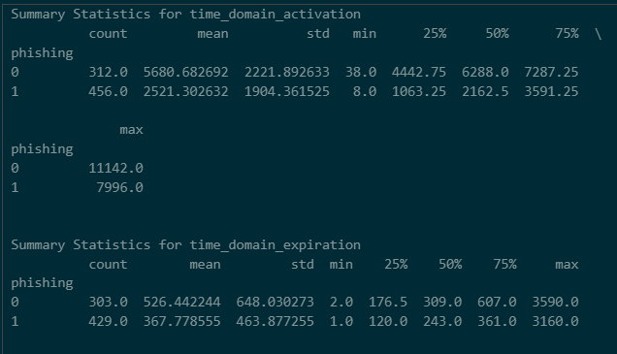
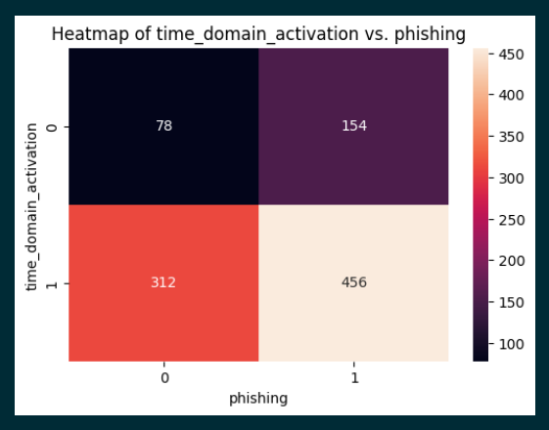
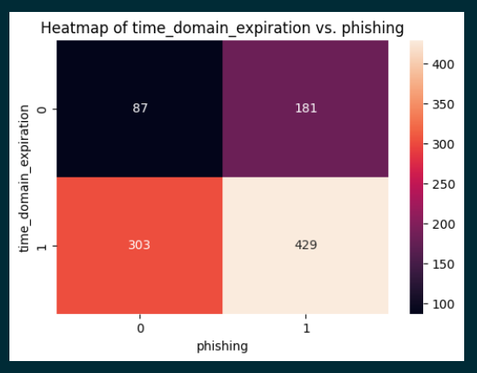
Exploratory Analysis
Analysing Mixed Variables
time_domain_activation and time_domain_expiration behave more like Numerical Variables

Slide 24
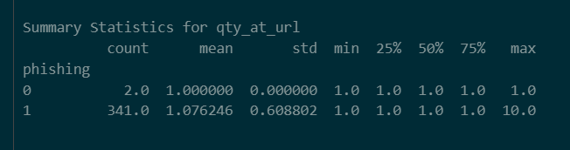
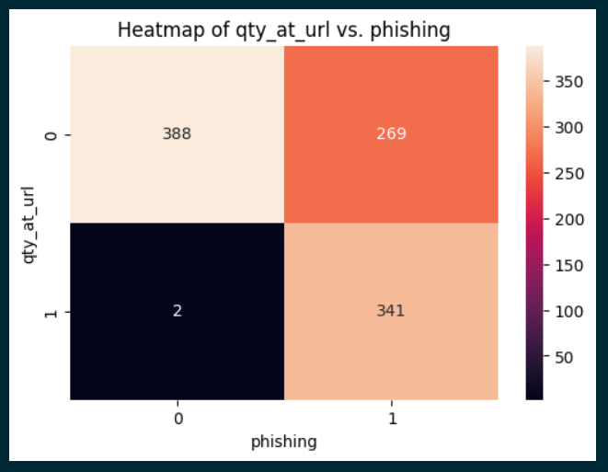
Exploratory Analysis
Analysing Mixed Variables
qty_at_url behaves more like Categorical Variables

Slide 25
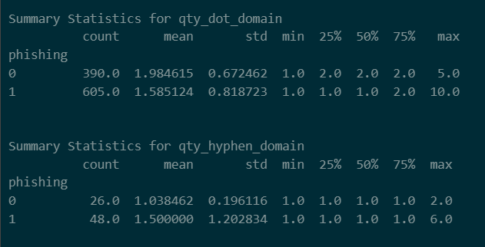
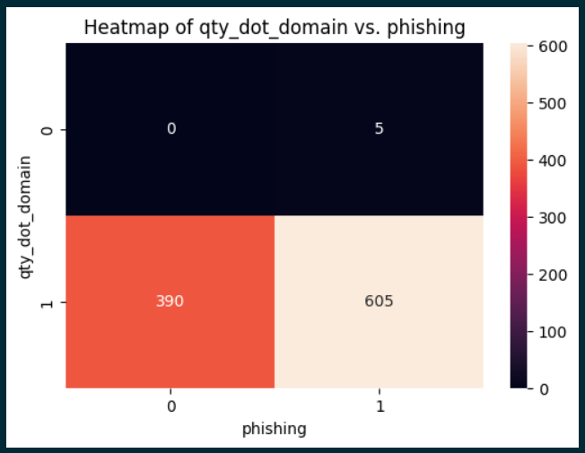
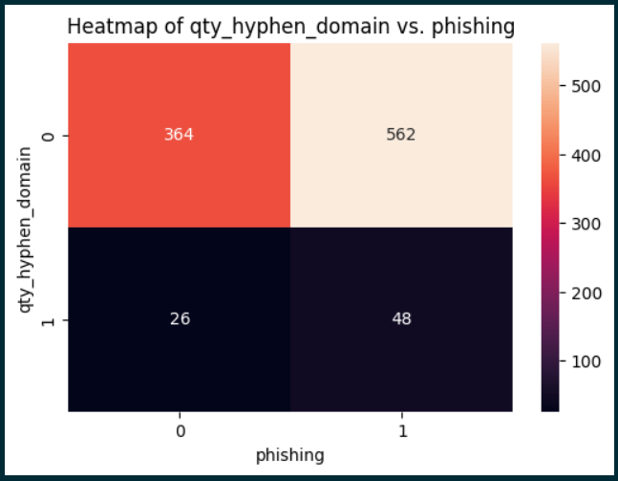

Exploratory Analysis
Analysing Mixed Variables
www.healthysnacks.com
Which of these look more like a phishing website?
Neither qty_dot_domain nor qty_hyphen_domain appear to have a strong correlation with phishing websites
www.hjrxpltznbvqrs.com

Slide 26
Feature Engineering
Consonant-To-Vowel Ratio
Consonant-To-Vowel Ratio:
Phishing URLs are crafted to look visually unusual, employing obfuscation techniques to deceive users.
Deviations from standard language patterns could indicate suspicious activity

Slide 27
Feature Engineering
Consonant-To-Vowel Ratio
10:3
www.healthysnacks.com
Which of these look more like a phishing website?
14:0
www.hjrxpltznbvqrs.com

Slide 28
Feature Engineering
Consonant-To-Vowel Ratio
10:3
www.healthysnacks.com
Consonant-To-Vowel Ratio
14:0
www.hjrxpltznbvqrs.com

Slide 29
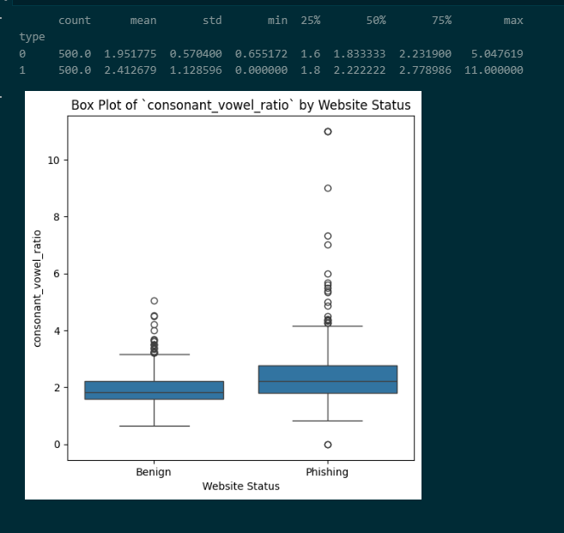
Feature Engineering
Consonant-To-Vowel Ratio
10:3
www.healthysnacks.com
Consonant-To-Vowel Ratios
We found a weak correlation between consonant-to-vowel ratios and phishing websites.
The slightly higher ratios observed in phishing URLs may simply be due to their increased length.
Consonant-To-Vowel Ratio
14:0
www.hjrxpltznbvqrs.com

Slide 30
Feature Engineering
Evaluating Strangeness
To address the limitations of detecting 'natural English' in URLs
Custom URL Strangeness Score (USS)

Slide 31
Feature Engineering
Evaluating Strangeness
Character Diversity Index
(CDI)
Domain Complexity Index
(DCI)
Overall Formula:
USS = 15(CDI) + 35(DCI) + 20(PCI) + 30(PRCI)
Path Complexity Index
(PCI)
Parameter Complexity Index (PRCI)

Slide 32
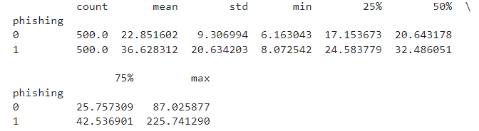
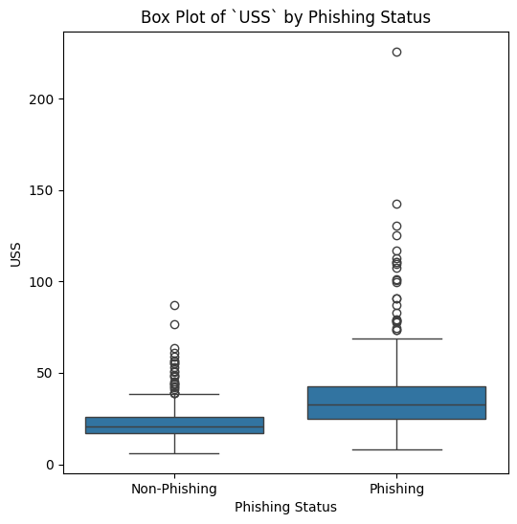
Feature Engineering
Evaluating Strangeness
Evaluating Strangeness
We found a stronger correlation between USS and phishing websites
USS is a more reliable feature compared to consonant-to-vowel ratio in determining a phishing website

Slide 33
Identifying variables for machine learning
From our exploratory analysis, we identified the following relations
Categorical
Numerical
Mixed
qty_at_url
Strong Positive Correlation / Relation
domain_in_ip
length_url
time_domain_activation
url_shortened
time_domain_expiration
Strong Negative Correlation / Relation
url_google_index
domain_google_index
Weak
Correlation / Relation
qty_dot_domain
tls_ssl_certificate
qty_hyphen_domain
Notes:
Removing weak relations

Slide 34
Identifying variables for machine learning
We remove variables with weak correlation / relations to predicting phishing
Categorical
Numerical
Mixed
qty_at_url
Strong Positive Correlation / Relation
domain_in_ip
length_url
time_domain_activation
url_shortened
time_domain_expiration
Strong Negative Correlation / Relation
url_google_index
domain_google_index

Slide 35
Identifying variables for machine learning
Next, we reclassify mixed variables to categorical or numerical based on prior analysis
Categorical
Numerical
Strong Positive Correlation / Relation
domain_in_ip
length_url
url_shortened
time_domain_activation
qty_at_url
time_domain_expiration
Strong Negative Correlation / Relation
url_google_index
domain_google_index

Slide 36
Defining our training dataset for machine learning
We split our filtered variables into 3 sets based on their type
Categorical
Numerical
Feature Engineered
domain_in_ip
length_url
url_strangeness_score
url_shortened
time_domain_activation
qty_at_url
time_domain_expiration
url_google_index
domain_google_index
*Categorical variables have already been integer encoded

Slide 37
Defining our training dataset for machine learning
We define the following training datasets to evaluate machine learning performance
Training Set 1, N
Numerical
We split the training dataset by 80/20 for train/test.
Same set of training data split was used across all model training to standardise accuracy benchmarking
Training Set 2, C
Categorical
Training Set 3, F
Feature Engineered
Training Set 4, NC
Numerical
+
Categorical
Training Set 5, NCF
Numerical
+
Categorical
+
Feature Engineered

Slide 38
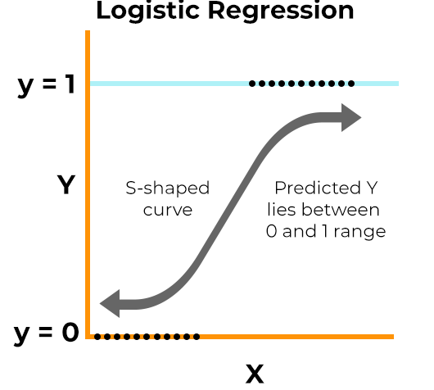
An Introduction to Logistic Regression
We used logistic regression for our first approach in predicting phishing URLs
Logistic regression is a supervised machine learning algorithm often used for binary classification tasks.
Since our categorical features have been integer encoded and our feature-engineered feature is numerical, we can directly use them as variables.
With N number of features, logistic regression aims to find a N-dimensional hyperplane to predict whether a URL is phishing or not.
N-dimensional hyperplane

Slide 39
Training a Logistic Regression model to predict phishing
Using our defined training datasets, we train five logistic regression models
Train Dataset
Test Dataset
ACC
TPR
FPR
ACC
TPR
FPR
Training Set 1, N
0.8369
0.7292
0.0905
0.8431
0.7378
0.0865
Training Set 2, C
0.6283
0.0776
0.0007
0.6302
0.0771
0.0006
Training Set 3, F
0.7185
0.4355
0.0908
0.7263
0.4439
0.0851
Training Set 4, NC
0.8415
0.7400
0.0901
0.8485
0.7491
0.0851
Training Set 5, NCF
0.8556
0.7374
0.0648
0.8621
0.7471
0.0612
ACC – Accuracy
TPR – True Positive Rate
FPR- False Positive Rate

Slide 40

Training a Logistic Regression model to predict phishing
Using our defined training datasets, we train five logistic regression models
Train Dataset
Test Dataset
ACC
TPR
FPR
ACC
TPR
FPR
Training Set 1, N
0.8369
0.7292
0.0905
3
0.8431
0.7378
0.0865
Training Set 2, C
0.6283
0.0776
0.0007
5
0.6302
0.0771
0.0006
Training Set 3, F
0.7185
0.4355
0.0908
4
0.7263
0.4439
0.0851
Training Set 4, NC
0.8415
0.7400
0.0901
2
0.8485
0.7491
0.0851
Training Set 5, NCF
0.8556
0.7374
0.0648
1
0.8621
0.7471
0.0612
ACC – Accuracy
TPR – True Positive Rate
FPR- False Positive Rate

Slide 41
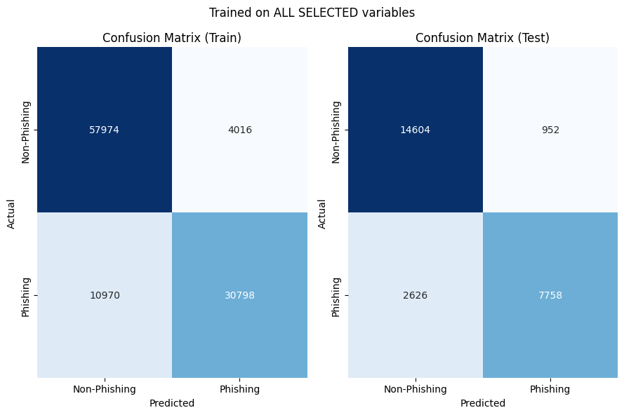
Training a Logistic Regression model to predict phishing
We plot a confusion matrix to show prediction results on the train and test sets
Train Dataset
Test Dataset
ACC
TPR
FPR
ACC
TPR
FPR
Training Set 5, NCF
0.8556
0.7374
0.0648
0.8621
0.7471
0.0612
ACC – Accuracy
TPR – True Positive Rate
FPR- False Positive Rate

Slide 42

An Introduction to Decision Trees
We used decision trees for our next approach in predicting phishing URLs
Decision Trees is a supervised machine learning algorithm often used for classification tasks.
It constructs a tree-like structure during training where at each decision node, a training set is recursively split into subsets based on a splitting criterion (i.e. Gini impurity).

Slide 43
Training a Decision Tree Classifier model to predict phishing
Using our defined training datasets, we train a five decision tree models
Train Dataset
Test Dataset
ACC
TPR
FPR
ACC
TPR
FPR
Training Set 1, N
0.9400
0.9064
0.0334
0.9175
0.8784
0.0564
Training Set 2, C
0.6283
0.0776
0.0006
0.6303
0.0771
0.0005
Training Set 3, F
0.9639
0.9240
0.0091
0.9314
0.8782
0.0330
Training Set 4, NC
0.9436
0.9064
0.0331
0.9193
0.8813
0.0553
Training Set 5, NCF
0.9872
0.9752
0.0047
0.9578
0.9397
0.0301
ACC – Accuracy
TPR – True Positive Rate
FPR- False Positive Rate

Slide 44
Training a Decision Tree Classifier model to predict phishing
Using our defined training datasets, we train a five decision tree models
Train Dataset
Test Dataset
ACC
TPR
FPR
ACC
TPR
FPR
Training Set 1, N
0.9400
0.9064
0.0334
4
0.9175
0.8784
0.0564
Training Set 2, C
0.6283
0.0776
0.0006
5
0.6303
0.0771
0.0005
Training Set 3, F
0.9639
0.9240
0.0091
2
0.9314
0.8782
0.0330
Training Set 4, NC
0.9436
0.9064
0.0331
3
0.9193
0.8813
0.0553
Training Set 5, NCF
0.9872
0.9752
0.0047
1
0.9578
0.9397
0.0301
ACC – Accuracy
TPR – True Positive Rate
FPR- False Positive Rate

Slide 45
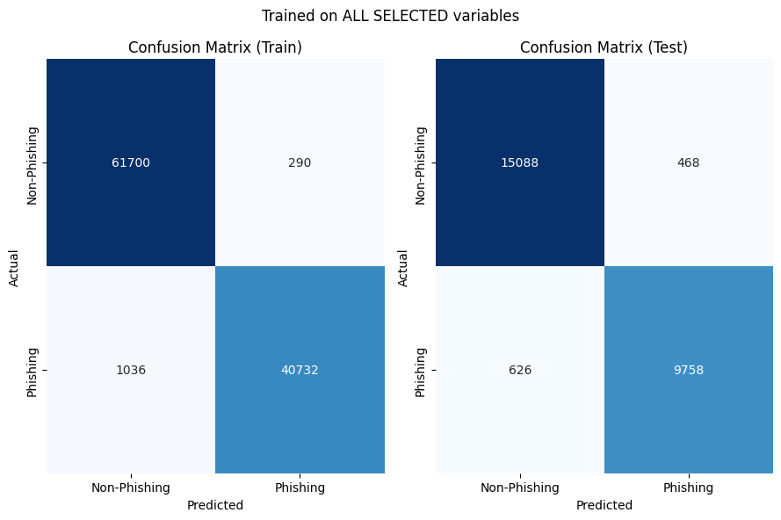
Training a Decision Tree Classifier model to predict phishing
We plot a confusion matrix to show prediction results on the train and test sets
Train Dataset
Test Dataset
ACC
TPR
FPR
ACC
TPR
FPR
Training Set 5, NCF
0.9872
0.9752
0.0047
0.9578
0.9397
0.0301
ACC – Accuracy
TPR – True Positive Rate
FPR- False Positive Rate

Slide 46
Comparing Logistic Regression and Decision Tree Classifier
We compare the accuracy on test sets for both types of models
Logistic Regression
Decision Trees
ACC (Test)
ACC (Test)
Training Set 1, N
0.8431
0.9175
Training Set 2, C
0.6302
0.6303
Training Set 3, F
0.7263
0.9314
Training Set 4, NC
0.8485
0.9193
Training Set 5, NCF
0.8621
0.9578
ACC – Accuracy

Slide 47
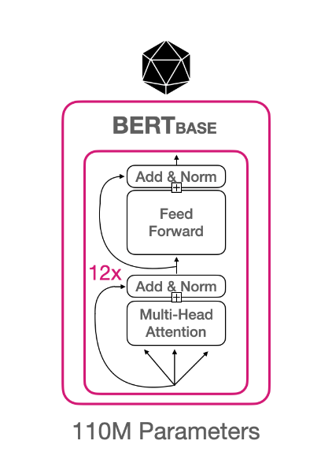
Beyond the coursework – Diving into Deep Learning
Natural Language Processing of URLs to detect phishing URLs using Transformers (BERT)
Transformers leverage an attention mechanism to effectively observe relationships between words.
BERT (Bidirectional Encoder Representations from Transformers) was a revolutionary deep learning model capable of contextual understanding (left-to-right and right-to-left direction) of words due to its self-attention mechanism.
By attaching a binary classification head (linear layer after BERT output) and finetuning the BERT model, we can train a BERT model to “understand” URLs and determine if they are phishing.
https://huggingface.co/google-bert/bert-base-cased

Slide 48
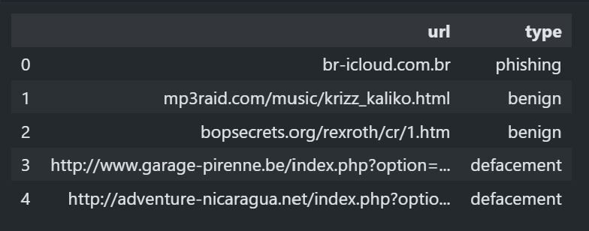
Beyond the coursework – Exploring a dataset with unparsed URLs
We used a dataset containing unprocessed URLs to directly leverage NLP techniques
We obtain a dataset containing 651,191 URLs with the following distribution:
428103 benign or safe URLs
96457 defacement URLs
94111 phishing URLs
32520 malware URLs.
*Output of data.head()
https://www.kaggle.com/datasets/sid321axn/malicious-urls-dataset/data

Slide 49
Beyond the coursework – Exploring a dataset with unparsed URLs
We preprocess the dataset to remove any irrelevant data
Since we are only concerned with identifying phishing websites, we clean the dataset by remove defacement and malware related URLs
To avoid data imbalance and model bias, we sample an equal amount of phishing and benign URLs (5000 each).
*Output of data.head()
https://www.kaggle.com/datasets/sid321axn/malicious-urls-dataset/data

Slide 50
Beyond the coursework – Tokenising unparsed URLs
To prepare URLs for fine-tuning Transformers, we first encode them into tokens
For Transformers to “understand” URLs, we first need to tokenise the URLs into a suitable representation.
BERT’s Sub-word Tokenizer
BERT uses a sub-word tokenization algorithm to decompose long strings into meaningful sub-words that allows the model to learn context-dependent representations.
Suitable for URLs as they are often single strings (Poor performance with word-level tokenizers).
URL input: br-icloud.com.br
Tokenised URL: ['br', '-', 'i', '##c', '##lou', '##d', '.', 'com', '.', 'br']

Slide 51
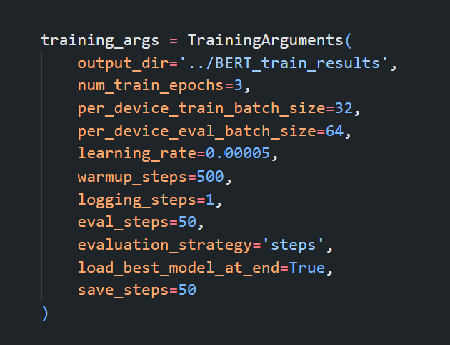
Beyond the coursework – Finetuning the BERT model
After tokenising all URLs, we finetune the BERT model across 3 epochs
Using the tokenized outputs of our training data, we split the training data by an 80/20 train/split ratio and finetune the BERT model.
The model was finetuned on our dataset over 3 epochs with a batch size of 32 and learning rate of 0.00005.

Slide 52
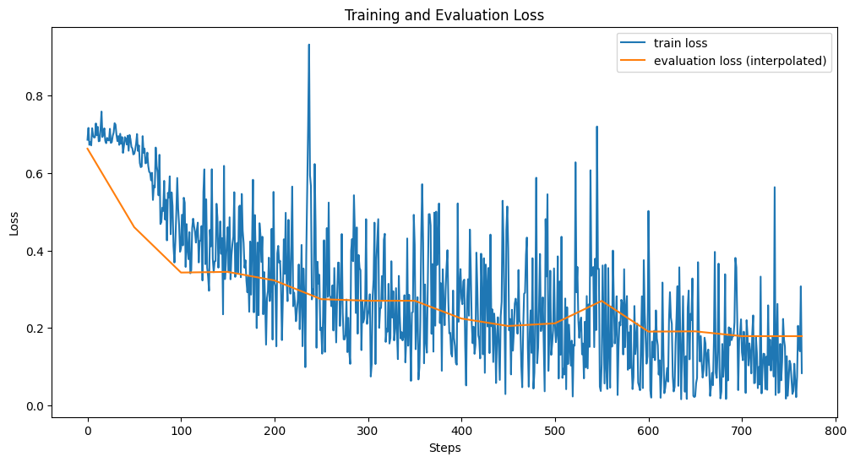
Beyond the coursework – Finetuning the BERT model
After tokenising all URLs, we finetune the BERT model across 3 epochs
Above shows our training loss and evaluation loss as the BERT model was finetuned.

Slide 53
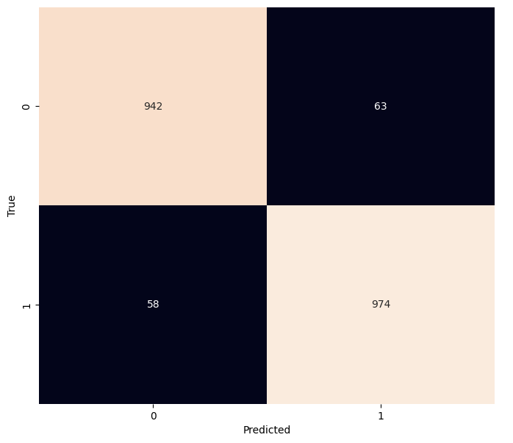
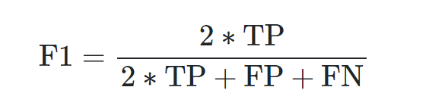
Beyond the coursework – Evaluating the BERT model
By just training on raw dataset, we obtained good performance on predicting phishing URLs
Model Performance:
Non-Phishing
Accuracy (Test): 0.9406
F1 Score (Test): 0.9415
*F1 score is a harmonic mean of precision and recall, providing a balance between both metrics.
Phishing
Our finetuned BERT model predicts phishing URLs with a high accuracy of 94%. A high F1 score of 0.9415 further supports the results indicating a good fit with little bias.
Non-Phishing
Phishing

Slide 54
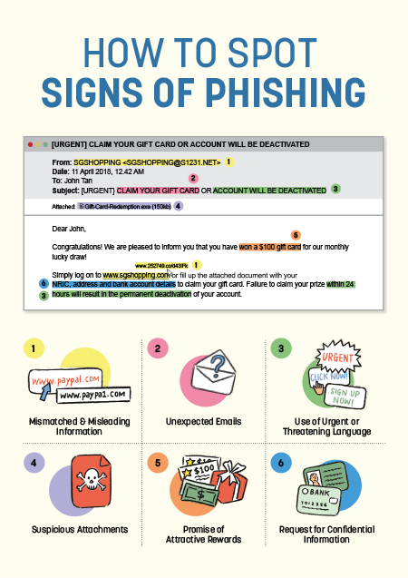
Future work and Areas for Improvement
In conclusion…
Future Work
Security advisories can include our analysed heuristics to educate the public on spotting phishing sites.
A publicly accessible web platform powered by our trained AI model can allow users to test if a website is indeed a phishing scam.
https://www.csa.gov.sg/our-programmes/cybersecurity-outreach/cybersecurity-campaigns/bettercybersafethansorry/Spot-Signs-Of-Phishing

Slide 55
Future work and Areas for Improvement
In conclusion…
Areas For Improvement
The USS Scoring Formula can be further enhanced by incorporating additional selected variables and refining scoring weights for optimal accuracy.
We can also train on a larger proportion of our available dataset for better generalisation of our machine learning and deep learning models.
https://www.csa.gov.sg/our-programmes/cybersecurity-outreach/cybersecurity-campaigns/bettercybersafethansorry/Spot-Signs-Of-Phishing

Slide 56
SC1015: Introduction
To Data Science &
Artificial Intelligence
Thank you!
Presented by:
Aidan Ling Zhen Yang
Lau Quan Feng, Ryan
Shem Lau Wei Yi

